Slide 1
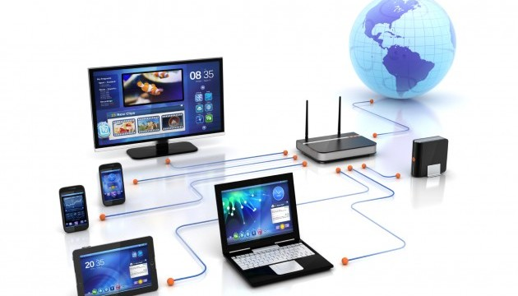
CSE101 Intro to CS and Programming
Basic Computer Networks
Lecture 9 (Week 5)
By Mr. Faheem Shaukat
faheem@iqraisb.edu.pk
www.tinyurl.com/IUICLectures

Slide 2
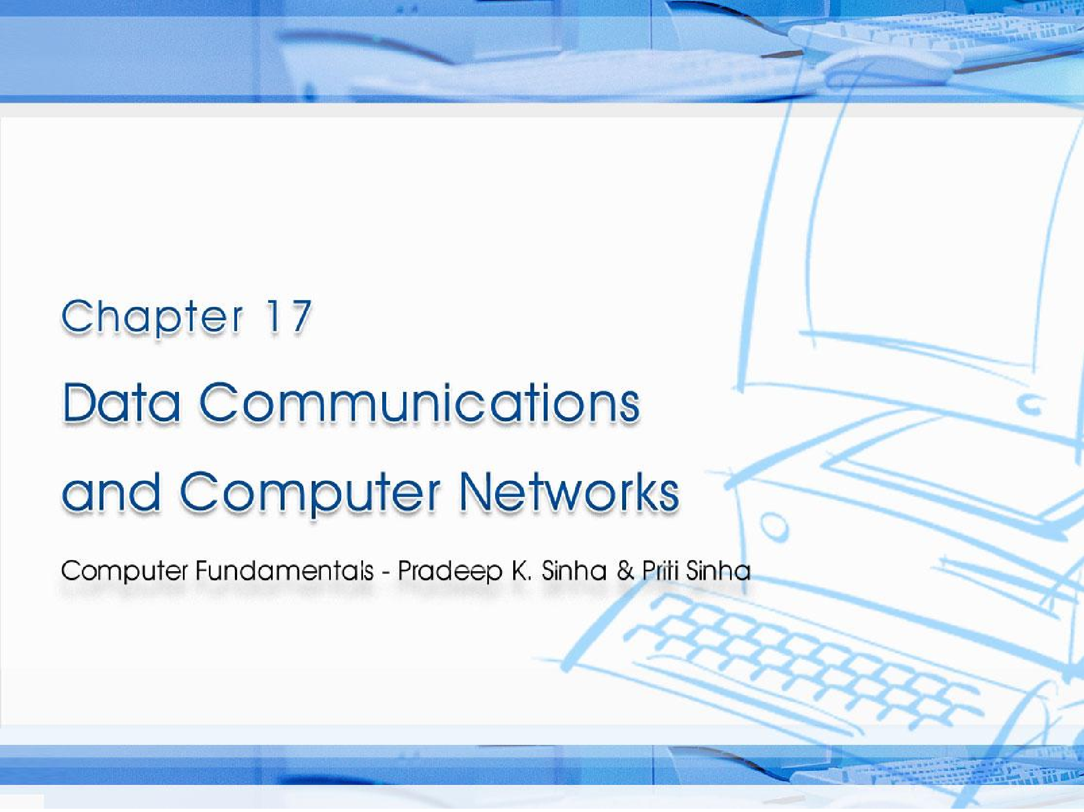
CCoommppuutterer FFununddaammenenttaallss:: PPrradadeeepep KK.. SSiinhanha && PPrriititi SSiinhanha
Ref. Page Chapter 17: Data Communications and Computer Networks Slide 1/57

Slide 3

Learning Objectives
Computer Fundamentals: Pradeep K. Sinha & Priti Sinha
In this chapter you will learn about:
What is Computer Network?
Basic elements of a communication system
Transmission Mode and Media
Analog and Digital Signal
Types of computer networks and Topology
OSI Model
Network Devices and Wireless Technologies
Ref. Page 320
Slide 2/57

Slide 4
Basic Definition
A computer network is a set of computers connected together for the purpose of sharing resources.
The Internet is the global system of interconnected computer networks
An intranet is a private network that is contained within an enterprise.

Slide 5
Basic Elements of a Communication System
Computer Fundamentals: Pradeep K. Sinha & Priti Sinha
Sender (source)
Medium
Carries the message
Receiver (sink)
Creates and sends a message
Receives the message
Ref. Page 321
Slide 3/57

Slide 6
Data Transmission Modes
Computer Fundamentals: Pradeep K. Sinha & Priti Sinha
Simplex mode data can be sent only through one direction, communication is unidirectional. We cannot send a message back to the sender.
Sender
Receiver
(a) Simplex
Half-duplex data transmission means that data can be transmitted in both directions on a signal carrier, but not at the same time.
Sender (or Receiver)
OR
(b) Half-duplex
Receiver (or Sender)
In full duplex system we can send data in both directions as it is bidirectional. Data can be sent in both directions simultaneously.
Sender (and Receiver)
Receiver (and Sender)
AND (c) Full-duplex
Ref. Page 321
Slide 4/57

Slide 7
Data Transmission Speed
Computer Fundamentals: Pradeep K. Sinha & Priti Sinha
Bandwidth: Range of frequencies available for data transmission. It refers to data transmission rate. Higher the bandwidth, the more data it can transmit
Baud: Unit of measurement of data transfer rate. Measured in bits per second (bps)
Ref. Page 322
Slide 5/57

Slide 8
Data Transmission Media
Computer Fundamentals: Pradeep K. Sinha & Priti Sinha
The most commonly used ones are:
Twisted-pair wire (UTP cable)
Coaxial cable
Microwave system
Communications satellite
Optical fibers
Ref. Page 323
Slide 7/57

Slide 9
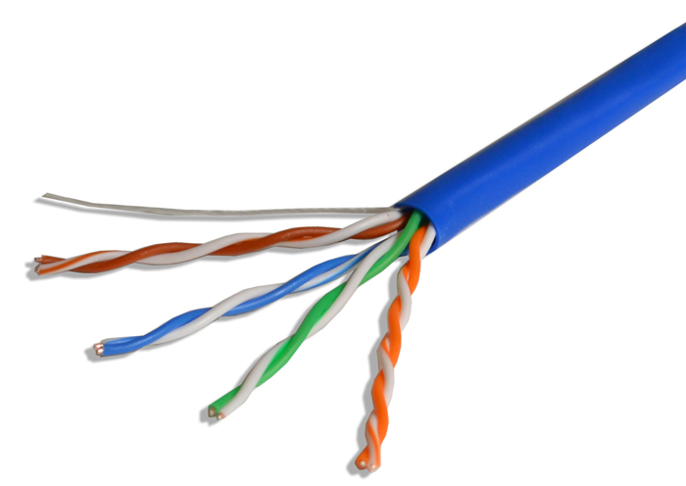
Unshielded Twisted-Pair (UTP) Cable
Computer Fundamentals: Pradeep K. Sinha & Priti Sinha
unshielded twisted pair, a popular type of cable that consists of two unshielded wires twisted around each other. Due to its low cost, UTP cabling is used extensively for local-area networks (LANs) and telephone connections.
Ref. Page 323
Slide 9/57

Slide 10
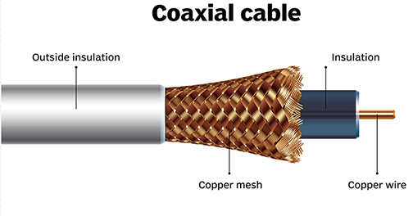
Coaxial Cable
Computer Fundamentals: Pradeep K. Sinha & Priti Sinha
Coaxial Cable is a type of electrical cable that has an inner conductor copper wire surrounded by a insulating layer, surrounded by a mesh shield and outer insulation.
Ref. Page 323
Slide 10/57

Slide 11
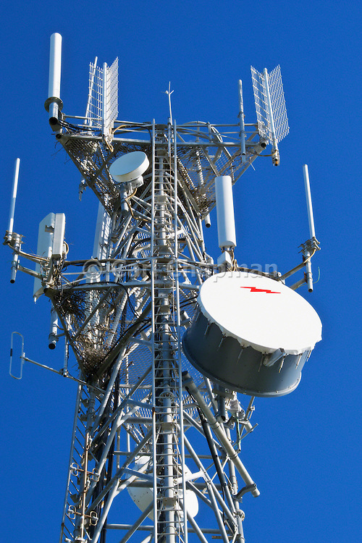
Microwave Communication System
Computer Fundamentals: Pradeep K. Sinha & Priti Sinha
Microwave communication is method of wirelessly sending data. It is very similar to radio technology. Microwaves are right next to radio waves on the electromagnetic spectrum.
Ref. Page 324
Slide 10/57

Slide 12
Satellite Communication System
Computer Fundamentals: Pradeep K. Sinha & Priti Sinha
A communications satellite is an artificial satellite that relays and amplifies radio telecommunications signals via a transponder; it creates a communication channel between a source transmitter and a receiver at different locations on Earth.
Satellite in space
6 GHz
4 GHz
Uplink
Downlink
Transmitting station on earth
Receiving station on earth
Ref. Page 325
Slide 11/57

Slide 13
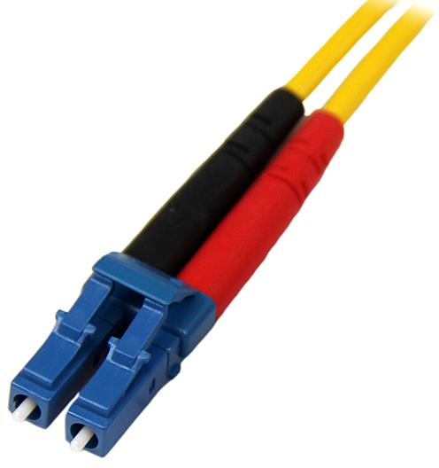
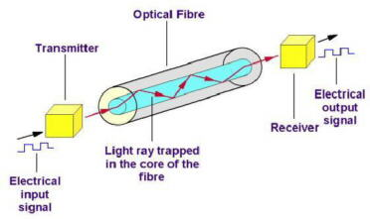
Optical Fiber Communication System
Computer Fundamentals: Pradeep K. Sinha & Priti Sinha
Fiber-optic communication is a method of transmitting information from one place to another by sending pulses of light through an optical fiber. The light forms an electromagnetic carrier wave that is modulated to carry information.
Ref. Page 326
Slide 12/57

Slide 14
Digital and Analog Data Transmission
Computer Fundamentals: Pradeep K. Sinha & Priti Sinha
Analog signal: Transmitted power varies over a continuous range. Example: sound, light, and radio waves
Digital signal: Sequence of voltage pulses represented in binary form
Computer generated data signal is digital, whereas telephone lines carry analog signals
Voltage
+v
v
1 1 1
1
t
0
0 0 0
(b) Digital signal
0
1/f 2/f
(a) Analog signal
t
-v
(Continued on next slide)
Ref. Page 327
Slide 13/57

Slide 15
Digital and Analog Data Transmission
Computer Fundamentals: Pradeep K. Sinha & Priti Sinha
(Continued from previous slide)
When digital data is to be sent over an analog facility, digital signals must be converted to analog form
Conversion of digital signal to analog form is known as modulation
Conversion of analog signal to digital form is known as demodulation
Digital transmission of data is preferred over analog transmission of data due to lower cost, higher transmission speeds, and lower error rate
Ref. Page 329

Slide 16
Modems
Computer Fundamentals: Pradeep K. Sinha & Priti Sinha
Modem is short for MOdulator/DEModulator
Special device used for conversion of digital data to analog form (modulation) and vice-versa (demodulation)
Essential piece of hardware where two digital devices (say two computers) want to communicate over an analog transmission channel (say a telephone line)
Ref. Page 328

Slide 17
Asynchronous and Synchronous Transmission
Computer Fundamentals: Pradeep K. Sinha & Priti Sinha
Two modes of data transmission on a communication line are asynchronous and synchronous
Asynchronous transmission
Sender can send data at any convenient time and the receiver will accept it
Data is transmitted character by character at irregular intervals
Well suited to many keyboard type terminals
(Continued on next slide)
Ref. Page 333

Slide 18
Asynchronous and Synchronous Transmission
Computer Fundamentals: Pradeep K. Sinha & Priti Sinha
Synchronous transmission
(Continued from previous slide)
Sender and receiver must synchronize with each other to get ready for data transmission before it takes place
Entire blocks of characters are framed and transmitted together
Well suited to remote communication between a computer and such devices as buffered terminals and printers
Ref. Page 333

Slide 19
Data Transmission
Computer Fundamentals: Pradeep K. Sinha & Priti Sinha
Irregular time intervals between two characters
Each character framed by start and stop bits
Character
Character Character
(a) Asynchronous transmission
Indefinite time interval between two blocks of data
A block of characters may consist of hundreds of characters
 | Char | Char |  |  |  | Char | Char |  | Char | Char
Trailer containing end of block indication
Header containing synchronizing and other information
(b) Synchronous transmission
Ref. Page 334

Slide 20
Network Topologies
Computer Fundamentals: Pradeep K. Sinha & Priti Sinha
Term network topology refers to the way in which the nodes of a network are linked together
Although number network topologies are possible, four major ones are:
Star Topology
Ring Topology
Mesh Topology
Bus Topology
Hybrid Network/Topology
Ref. Page 338

Slide 21
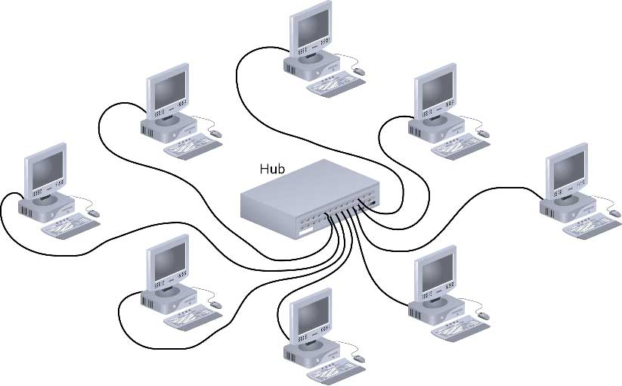
Star Topology/Network
Computer Fundamentals: Pradeep K. Sinha & Priti Sinha
A star topology is a topology for a Local Area Network (LAN) in which all nodes are individually connected to a central connection point, like a hub or a switch.
Ref. Page 339

Slide 22
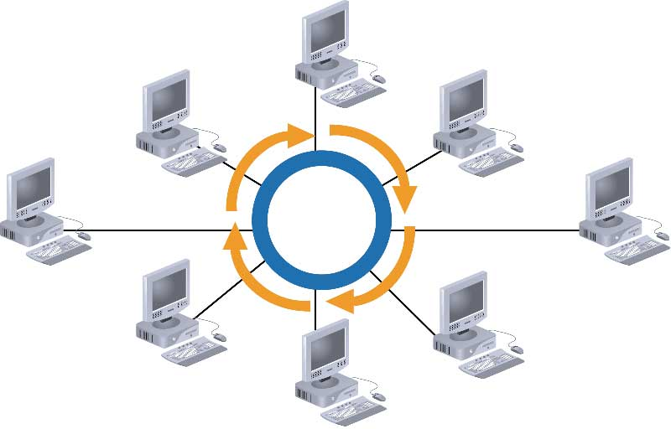
Ring Network Topology
Computer Fundamentals: Pradeep K. Sinha & Priti Sinha
A ring network is a network topology in which each node connects to exactly two other nodes, forming a single continuous pathway for signals through each node - a ring.
Ref. Page 339

Slide 23
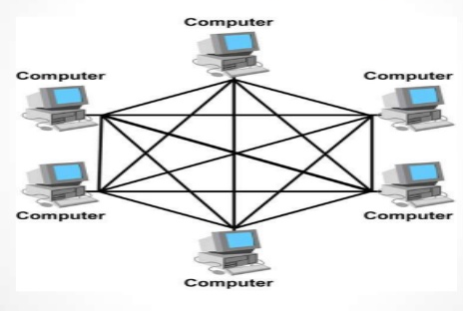
Mesh Network Topology
Computer Fundamentals: Pradeep K. Sinha & Priti Sinha
In a mesh network topology, each of the network node, computer and other devices, are interconnected with one another.
Ref. Page 340

Slide 24
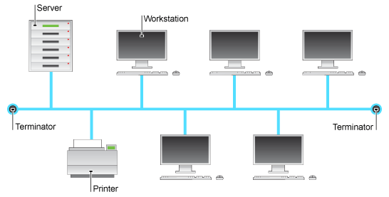
Bus Network Topology
Computer Fundamentals: Pradeep K. Sinha & Priti Sinha
A bus network is a network topology in which nodes are directly connected to a common linear (or branched) half-duplex link called a bus.
Ref. Page 341

Slide 25
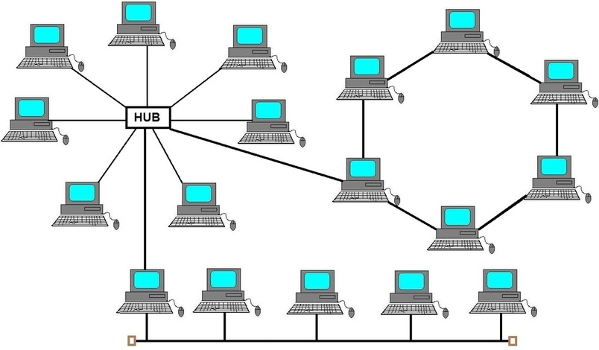
Hybrid Network Topology
Computer Fundamentals: Pradeep K. Sinha & Priti Sinha
Hybrid network topology is a combination of two or more different basic network topologies. For example, it can be star-ring, star-bus topologies, etc.
Ref. Page 341

Slide 26
Network Types
Computer Fundamentals: Pradeep K. Sinha & Priti Sinha
Networks are broadly classified into two types: Local Area Network (LAN) and Wide Area Network (WAN)
A local area network (LAN) is a network that connects computers and other devices in a relatively small area, typically a single building or a group of buildings.
A wide area network (WAN) is a telecommunications network or computer network that extends over a large geographical distance.
A personal area network (PAN) is a technology that could enable wearable smart devices to communicate with other nearby devices.
Metropolitan Area Network (MAN) covered area larger then LAN and less then WAN
Ref. Page 342

Slide 27
Network Interface Card (NIC)
Computer Fundamentals: Pradeep K. Sinha & Priti Sinha
Hardware device that allows a computer to be connected to a network, both functionally and physically
Printed circuit board installed on to one of the expansion slots of computer
Provides a port on the back to which network cable is attached
Ref. Page 344

Slide 28
The OSI Model
Computer Fundamentals: Pradeep K. Sinha & Priti Sinha
The Open System Interconnection (OSI) model is framework for defining standards for linking heterogeneous computers in a packet switched network
Standardized OSI protocol makes it possible for any two heterogeneous computer systems, located anywhere in the world, to easily communicate with each other
Separate set of protocols is defined for each layer in its seven-layer architecture. Each layer has an independent function
Ref. Page 344

Slide 29
Layers, Interfaces, and Protocols in the OSI Model
Computer Fundamentals: Pradeep K. Sinha & Priti Sinha
Node 1 Node 2
Process A
Process B
Layer 7 (application)
Application protocol
Layer 7 (application)
Interface
Interface
Layer 6
Presentation protocol
Layer 6 (presentation)
(presentation)
Interface
Interface
Layer 5 (session)
Session protocol
Layer 5 (session)
Interface
Interface
Layer 4 (transport)
Transport protocol
Layer 4
(transport)
Interface
Network protocol
Interface
Layer 3 (network)
Layer 3 (network)
Interface
Interface
Layer 2 (data link)
Data-link protocol
Layer 2
(data link)
Interface
Interface
Layer 1 (physical)
Physical protocol
Layer 1 (physical)
Network
Ref. Page 346

Slide 30
Computer Fundamentals: Pradeep K. Sinha & Priti Sinha
An example illustrating transfer of message M from sending node to the receiving node in the OSI model: H_{n}, header added by layer n:T_{n}, trailer added by layer n.
Sending node
Receiving node
Process A
Process B
H₇
M
H₇
M
H₆ | H | M
H₆ | H₇ | M
7
H₅ | H₆ | H₇ | M
H₅ | H₆ | H₇ | M
H₄ | H₅ | H₆ | H₇ | M₁
H₄ | H₅ | H₆ | H₇ | M₂
H₄ | H₅ | H₆ | H₇ | M₁
H₄ | H₅ | H₆ | H₇ | M₂
H₃ | H₄ | H₅ | H₆ | H₇ | M₁
H₃ | H₄ | H₅ | H₆ | H₇ | M₂
H₃ | H₄ | H₅ | H₆ | H₇ | M₁
H₃ | H₄ | H₅ | H₆ | H₇ | M₂
H₂ | H₃ | H₄ | H₅ | H₆ | H₇ | M₁ | T₂
H₂ | H₃ | H₄ | H₅ | H₆ | H₇ | M | T₂
H₂ | H₃ | H₄ | H₅ | H₆ | H₇ | M | 1 ^{T}2
H₂ | H₃ | H₄ | H₅ | H₆ | H₇ | M | T₂
2
2
Ref. Page 348

Slide 31
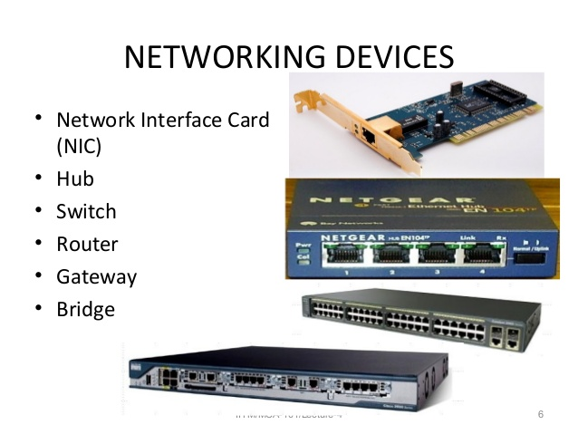
Network Devices Name

Slide 32
Network Devices Definition
Computer Fundamentals: Pradeep K. Sinha & Priti Sinha
Hub is a networking device which is used to connect multiple network hosts. A network hub is also used to do data transfer.
Switch also works at the layer of LAN (Local Area Network) but you can say that a switch is more intelligent than a hub. While hub just does the work of data forwarding, a switch does ‘filter and forwarding.
Router is a network device which is responsible for routing traffic from one to another network.
Repeater is an electronic device that amplifies the signal it receives.
Ref. Page 349

Slide 33
Wireless Technologies
Computer Fundamentals: Pradeep K. Sinha & Priti Sinha
2G and 3G
Wireless LAN
WiMAX
Wireless Local Loop (WLL)
Radio-router
Multihop Wireless Network
Wireless Application Protocol (WAP)
Ref. Page 351

